Slide 1
Chapter 4
Digital Design and Computer Architecture, 2nd Edition
David Money Harris and Sarah L. Harris

Slide 2
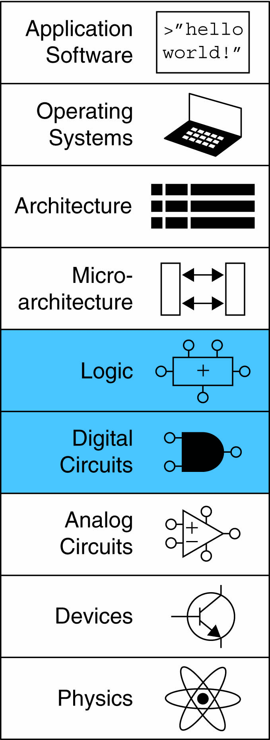
Chapter 4 :: Topics
Introduction
Combinational Logic
Structural Modeling
Sequential Logic
More Combinational Logic
Finite State Machines
Parameterized Modules
Testbenches

Slide 3
Introduction
Hardware description language (HDL):
specifies logic function only
Computer-aided design (CAD) tool produces or synthesizes the optimized gates
Most commercial designs built using HDLs
Two leading HDLs:
SystemVerilog
developed in 1984 by Gateway Design Automation
IEEE standard (1364) in 1995 (Verilog 95)
Extended in 2001 (Verilog 2001)
Extended in 2005, renamed SystemVerilog (IEEE STD 1800-2009)
VHDL 2008
Developed in 1981 by the Department of Defense
IEEE standard (1076) in 1987
Updated in 2008 (IEEE STD 1076-2008)

Slide 4
HDL to Gates
Simulation
Inputs applied to circuit
Outputs checked for correctness
Millions of dollars saved by debugging in simulation instead of hardware
Synthesis
Transforms HDL code into a netlist describing the hardware (i.e., a list of gates and the wires connecting them)
IMPORTANT:
When using an HDL, think of the hardware the HDL should produce

Slide 5
SystemVerilog Modules
Two types of Modules:
Behavioral: describe what a module does
Structural: describe how it is built from simpler modules

Slide 6
Behavioral SystemVerilog
SystemVerilog:
module example(input logic a, b, c,
output logic y);
assign y = ~a & ~b & ~c | a & ~b & ~c | a & ~b & c;
endmodule

Slide 7
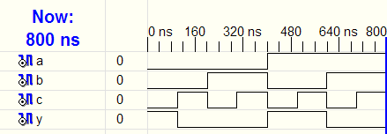
HDL Simulation
SystemVerilog:
module example(input logic a, b, c,
output logic y);
assign y = ~a & ~b & ~c | a & ~b & ~c | a & ~b & c;
endmodule

Slide 8
HDL Synthesis
SystemVerilog:
module example(input logic a, b, c,
output logic y);
assign y = ~a & ~b & ~c | a & ~b & ~c | a & ~b & c;
endmodule
Synthesis:

Slide 9
SystemVerilog Syntax
Case sensitive
Example: reset and Reset are not the same signal.
No names that start with numbers
Example: 2mux is an invalid name
Whitespace ignored
Comments:
// single line comment
/* multiline
comment */

Slide 10
Structural Modeling - Hierarchy
module and3(input logic a, b, c,
output logic y);
assign y = a & b & c;
endmodule
module inv(input logic a,
output logic y);
assign y = ~a;
endmodule
module nand3(input logic a, b, c
output logic y);
logic n1; // internal signal
and3 andgate(a, b, c, n1); // instance of and3
inv inverter(n1, y); // instance of inverter
endmodule

Slide 11
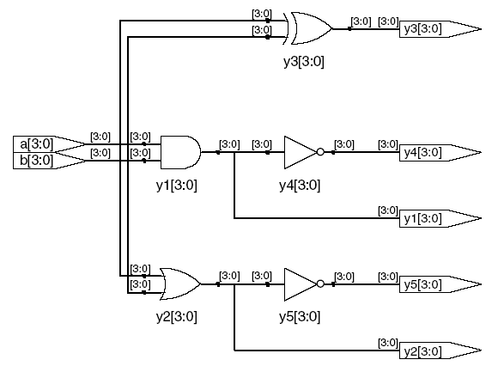
Bitwise Operators
module gates(input logic [3:0] a, b,
output logic [3:0] y1, y2, y3, y4, y5);
/* Five different two-input logic
gates acting on 4 bit busses */
assign y1 = a & b; // AND
assign y2 = a | b; // OR
assign y3 = a ^ b; // XOR
assign y4 = ~(a & b); // NAND
assign y5 = ~(a | b); // NOR
endmodule
// single line comment
/*…*/ multiline comment

Slide 12
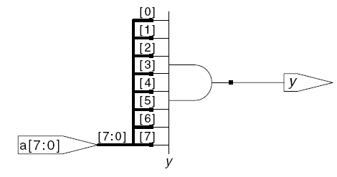
Reduction Operators
module and8(input logic [7:0] a,
output logic y);
assign y = &a;
// &a is much easier to write than
// assign y = a[7] & a[6] & a[5] & a[4] &
// a[3] & a[2] & a[1] & a[0];
endmodule

Slide 13
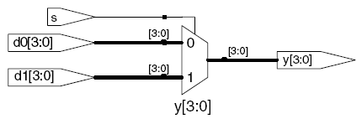
Conditional Assignment
module mux2(input logic [3:0] d0, d1,
input logic s,
output logic [3:0] y);
assign y = s ? d1 : d0;
endmodule
? : is also called a ternary operator because it
operates on 3 inputs: s, d1, and d0.

Slide 14
Internal Variables
module fulladder(input logic a, b, cin,
output logic s, cout);
logic p, g; // internal nodes
assign p = a ^ b;
assign g = a & b;
assign s = p ^ cin;
assign cout = g | (p & cin);
endmodule

Slide 15
Precedence
Order of operations
Highest
~ | NOT
*, /, % | mult, div, mod
+, - | add,sub
<<, >> | shift
<<<, >>> | arithmetic shift
<, <=, >, >= | comparison
==, != | equal, not equal
&, ~& | AND, NAND
^, ~^ | XOR, XNOR
|, ~| | OR, NOR
?: | ternary operator
Lowest

Slide 16
Numbers
Format: N'Bvalue
N = number of bits, B = base
N'B is optional but recommended (default is decimal)
Number | # Bits | Base | Decimal Equivalent | Stored
3'b101 | 3 | binary | 5 | 101
'b11 | unsized | binary | 3 | 00…0011
8'b11 | 8 | binary | 3 | 00000011
8'b1010_1011 | 8 | binary | 171 | 10101011
3'd6 | 3 | decimal | 6 | 110
6'o42 | 6 | octal | 34 | 100010
8'hAB | 8 | hexadecimal | 171 | 10101011
42 | Unsized | decimal | 42 | 00…0101010

Slide 17
Bit Manipulations: Example 1
assign y = {a[2:1], {3{b[0]}}, a[0], 6'b100_010};
// if y is a 12-bit signal, the above statement produces:
y = a[2] a[1] b[0] b[0] b[0] a[0] 1 0 0 0 1 0
// underscores (_) are used for formatting only to make it easier to read. SystemVerilog ignores them.

Slide 18
Bit Manipulations: Example 2
SystemVerilog:
module mux2_8(input logic [7:0] d0, d1,
input logic s,
output logic [7:0] y);
mux2 lsbmux(d0[3:0], d1[3:0], s, y[3:0]);
mux2 msbmux(d0[7:4], d1[7:4], s, y[7:4]);
endmodule

Slide 19
Z: Floating Output
SystemVerilog:
module tristate(input logic [3:0] a,
input logic en,
output logic [3:0] y);
assign y = en ? a : 4'bz;
endmodule

Slide 20
Delays – Ignored for synthesis!
module example(input logic a, b, c,
output logic y);
logic ab, bb, cb, n1, n2, n3;
assign #1 {ab, bb, cb} = ~{a, b, c};
assign #2 n1 = ab & bb & cb;
assign #2 n2 = a & bb & cb;
assign #2 n3 = a & bb & c;
assign #4 y = n1 | n2 | n3;
endmodule

Slide 21
Delays – Ignored for synthesis!
module example(input logic a, b, c,
output logic y);
logic ab, bb, cb, n1, n2, n3;
assign #1 {ab, bb, cb} =
~{a, b, c};
assign #2 n1 = ab & bb & cb;
assign #2 n2 = a & bb & cb;
assign #2 n3 = a & bb & c;
assign #4 y = n1 | n2 | n3;
endmodule

Slide 22
Sequential Logic
SystemVerilog uses Idioms to describe latches, flip-flops and FSMs
Other coding styles may simulate correctly but produce incorrect hardware
SystemVerilog is backwards compatible with older Verilog versions that had error-prone idioms
You should always use the SystemVerilog constructs, but you should know how to recognize and interpret older Verilog.

Slide 23
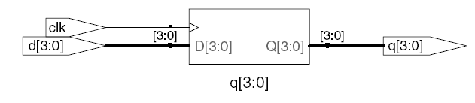
D Flip-Flop
module flop(input logic clk,
input logic [3:0] d,
output logic [3:0] q);
always_ff @(posedge clk)
q <= d; // pronounced “q gets d”
endmodule

Slide 24
Resettable D Flip-Flop
module flopr(input logic clk,
input logic reset,
input logic [3:0] d,
output logic [3:0] q);
// synchronous reset
always_ff @(posedge clk)
if (reset) q <= 4'b0;
else q <= d;
endmodule

Slide 25
Resettable D Flip-Flop
module flopr(input logic clk,
input logic reset,
input logic [3:0] d,
output logic [3:0] q);
// asynchronous reset
always_ff @(posedge clk, posedge reset)
if (reset) q <= 4'b0;
else q <= d;
endmodule

Slide 26
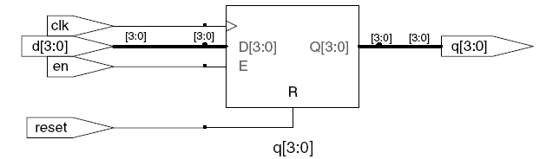
D Flip-Flop with Enable
module flopren(input logic clk,
input logic reset,
input logic en,
input logic [3:0] d,
output logic [3:0] q);
// asynchronous reset and enable
always_ff @(posedge clk, posedge reset)
if (reset) q <= 4'b0;
else if (en) q <= d;
endmodule

Slide 27
Latch
module latch(input logic clk,
input logic [3:0] d,
output logic [3:0] q);
always_latch
if (clk) q <= d;
endmodule
Warning: We don’t use latches in this text. But you might write code that inadvertently implies a latch. Check synthesized hardware – if it has latches
in it, there’s an error.

Slide 28
Other Behavioral Statements
Statements that must be inside always statements:
if / else
case, casez

Slide 29
Combinational Logic using always
// combinational logic using an always statement
module gates(input logic [3:0] a, b,
output logic [3:0] y1, y2, y3, y4, y5);
always_comb // need begin/end because there is
begin // more than one statement in always
y1 = a & b; // AND
y2 = a | b; // OR
y3 = a ^ b; // XOR
y4 = ~(a & b); // NAND
y5 = ~(a | b); // NOR
end
endmodule
This hardware could be described with assign statements using fewer lines of code, so it’s better to use assign statements in this case.

Slide 30
Combinational Logic using case
module sevenseg(input logic [3:0] data,
output logic [6:0] segments);
always_comb
case (data)
// abc_defg
0: segments = 7'b111_1110;
1: segments = 7'b011_0000;
2: segments = 7'b110_1101;
3: segments = 7'b111_1001;
4: segments = 7'b011_0011;
5: segments = 7'b101_1011;
6: segments = 7'b101_1111;
7: segments = 7'b111_0000;
8: segments = 7'b111_1111;
9: segments = 7'b111_0011;
default: segments = 7'b000_0000; // required
endcase
endmodule

Slide 31
Combinational Logic using case
case statement implies combinational logic only if all possible input combinations described
Remember to use default statement

Slide 32
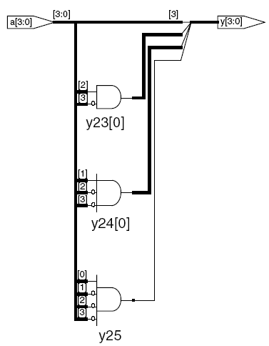
Combinational Logic using casez
module priority_casez(input logic [3:0] a,
output logic [3:0] y);
always_comb
casez(a)
4'b1???: y = 4'b1000; // ? = don’t care
4'b01??: y = 4'b0100;
4'b001?: y = 4'b0010;
4'b0001: y = 4'b0001;
default: y = 4'b0000;
endcase
endmodule

Slide 33
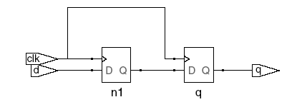

Blocking vs. Nonblocking Assignment
<= is nonblocking assignment
Occurs simultaneously with others
= is blocking assignment
Occurs in order it appears in file
// Good synchronizer using
// nonblocking assignments
module syncgood(input logic clk,
input logic d,
output logic q);
logic n1;
always_ff @(posedge clk)
begin
n1 <= d; // nonblocking
q <= n1; // nonblocking
end
endmodule
// Bad synchronizer using
// blocking assignments
module syncbad(input logic clk,
input logic d,
output logic q);
logic n1;
always_ff @(posedge clk)
begin
n1 = d; // blocking
q = n1; // blocking
end
endmodule

Slide 34
Rules for Signal Assignment
Synchronous sequential logic: use always_ff @(posedge clk) and nonblocking assignments (<=)
always_ff @ (posedge clk)
q <= d; // nonblocking
Simple combinational logic: use continuous assignments (assign…)
assign y = a & b;
More complicated combinational logic: use always_comb and blocking assignments (=)
Assign a signal in only one always statement or continuous assignment statement.

Slide 35
Trip down memory lane: Verilog 95/2001: D Flip-Flop
module flop(input clk,
input [3:0] d,
output reg [3:0] q);
always @ (posedge clk)
q <= d; // pronounced “q gets d”
endmodule
Any signal assigned in an always statement must be declared reg. In this case q is declared as reg
Beware: A variable declared reg is not necessarily a registered output.
We will show examples of this later.

Slide 36
Trip down memory lane: Verilog 95/2001 Resettable D Flip-Flop
module flopr(input clk,
input reset,
input [3:0] d,
output reg [3:0] q);
// synchronous reset
always @ (posedge clk)
if (reset) q <= 4'b0;
else q <= d;
endmodule

Slide 37
Trip down memory lane: Verilog 95/2001 Resettable D Flip-Flop
module flopr(input clk,
input reset,
input [3:0] d,
output reg [3:0] q);
// asynchronous reset
always @ (posedge clk, posedge reset)
if (reset) q <= 4'b0;
else q <= d;
endmodule

Slide 38
Trip down memory lane: Verilog 95/2001: D Flip-Flop with Enable
module flopren(input clk,
input reset,
input en,
input [3:0] d,
output reg [3:0] q);
// asynchronous reset and enable
always @ (posedge clk, posedge reset)
if (reset) q <= 4'b0;
else if (en) q <= d;
endmodule

Slide 39
Trip down memory lane: Verilog 95/2001 Latch
module latch(input clk,
input [3:0] d,
output reg [3:0] q);
always @ (clk, d) //or you could use always @*
if (clk) q <= d;
endmodule
Warning: We won’t use latches in this course, but you might write code that inadvertently implies a latch. So if your synthesized hardware has latches in it, this indicates an error.

Slide 40
Trip down memory lane: Verilog 95/2001: Other Behavioral Statements
Statements that must be inside always statements:
if / else
case, casez
Reminder: Variables assigned in Verilog 95/2001 always statement must be declared as reg (even if they’re not actually registers!). Quartus is lenient about this but not every tool is so lenient.
In SystemVerilog you should use “logic” for both combinational and registered signals. Function will be determined by the nature of the Always clause.

Slide 41
Trip down memory lane: Verilog 95/2001: Combinational Logic using always
// combinational logic using an always statement
module gates(input [3:0] a, b,
output reg [3:0] y1, y2, y3, y4, y5);
always @(*) // need begin/end because there is
begin // more than one statement in always
y1 = a & b; // AND
y2 = a | b; // OR
y3 = a ^ b; // XOR
y4 = ~(a & b); // NAND
y5 = ~(a | b); // NOR
end
endmodule
This hardware could be described with assign statements using fewer lines of code, so it’s better to use assign statements in this case.

Slide 42
Trip down memory lane: Verilog 95/2001: Combinational Logic using case
module sevenseg(input [3:0] data,
output reg [6:0] segments);
always @(*)
case (data)
// abc_defg
0: segments = 7'b111_1110;
1: segments = 7'b011_0000;
2: segments = 7'b110_1101;
3: segments = 7'b111_1001;
4: segments = 7'b011_0011;
5: segments = 7'b101_1011;
6: segments = 7'b101_1111;
7: segments = 7'b111_0000;
8: segments = 7'b111_1111;
9: segments = 7'b111_1011;
default: segments = 7'b000_0000; // required
endcase
endmodule

Slide 43
Trip down memory lane: Verilog 95/2001: Rules for Signal Assignment
Use always @(posedge clk) and nonblocking assignments (<=) to model synchronous sequential logic
always @ (posedge clk)
q <= d; // nonblocking
Use continuous assignments (assign …)to model simple combinational logic.
assign y = a & b;
Use always @ (*) and blocking assignments (=) to model more complicated combinational logic where the always statement is helpful.
Do not make assignments to the same signal in more than one always statement or continuous assignment statement.

Slide 44
Finite State Machines (FSMs)
Three blocks:
next state logic
state register
output logic

Slide 45
FSM Example: Divide by 3
The double circle indicates the reset state

Slide 46
FSM in SystemVerilog
module divideby3FSM (input logic clk,
input logic reset,
output logic q);
typedef enum logic [1:0] {S0, S1, S2} statetype;
statetype [1:0] state, nextstate;
// state register
always_ff @ (posedge clk, posedge reset)
if (reset) state <= S0;
else state <= nextstate;
// next state logic
always_comb
case (state)
S0: nextstate = S1;
S1: nextstate = S2;
S2: nextstate = S0;
default: nextstate = S0;
endcase
// output logic
assign q = (state == S0);
endmodule

Slide 47
Parameterized Modules
2:1 mux:
module mux2
#(parameter width = 8) // name and default value
(input logic [width-1:0] d0, d1,
input logic s,
output logic [width-1:0] y);
assign y = s ? d1 : d0;
endmodule
Instance with 8-bit bus width (uses default):
mux2 mux1(d0, d1, s, out);
Instance with 12-bit bus width:
mux2 #(12) lowmux(d0, d1, s, out);

Slide 48
Counters
Increments on each clock edge
Used to cycle through numbers. For example,
000, 001, 010, 011, 100, 101, 110, 111, 000, 001…
Example uses:
Digital clock displays
Program counter: keeps track of current instruction executing
Notes:
48

Slide 49
Shift Registers
Shift a new bit in on each clock edge
Shift a bit out on each clock edge
Serial-to-parallel converter: converts serial input (S_{in}) to parallel output (Q_{0:N-1})
Symbol:
Implementation:
Notes:
49

Slide 50
Shift Register with Parallel Load
When Load = 1, acts as a normal N-bit register
When Load = 0, acts as a shift register
Now can act as a serial-to-parallel converter (S_{in} to Q_{0:N-1}) or a parallel-to-serial converter (D_{0:N-1} to S_{out})
Notes:
50

Slide 51
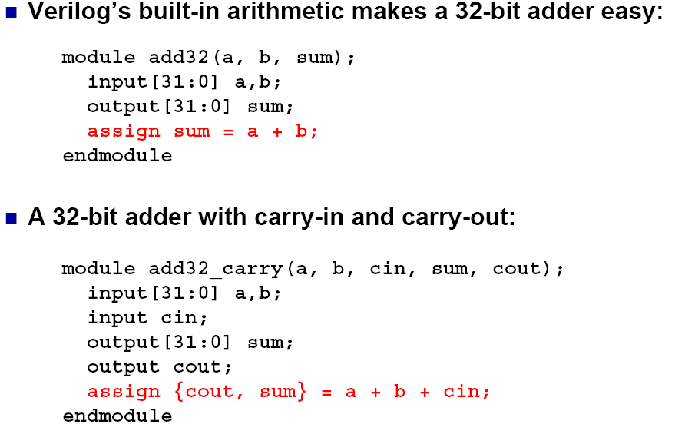
The Power of Verilog: Integer Arithmetic

Slide 52
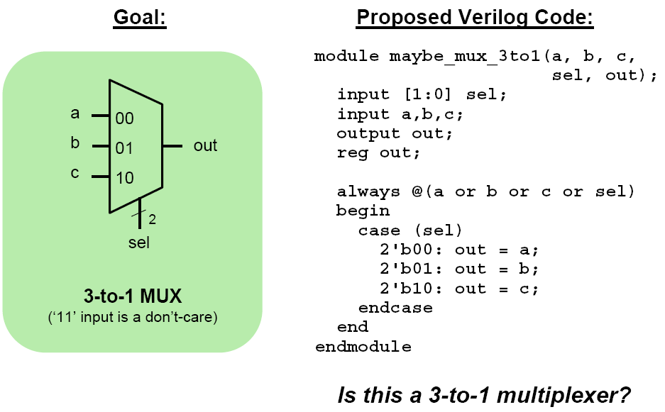
Dangers of Verilog: Incomplete Specification

Slide 53
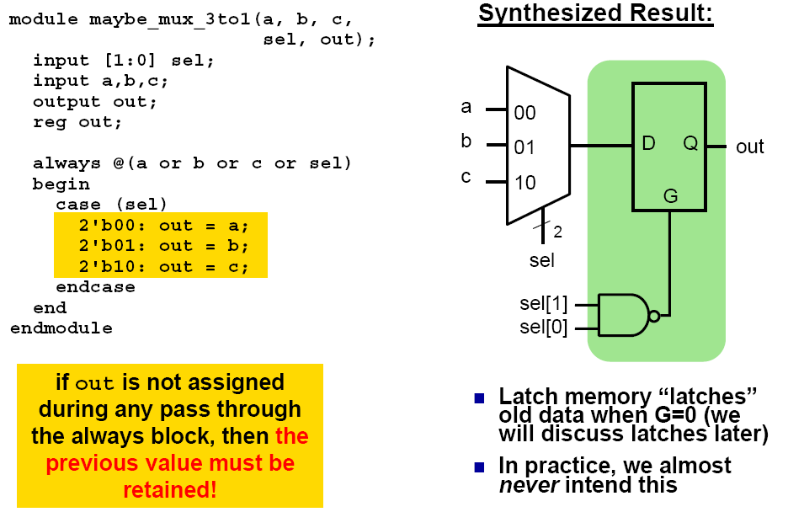
Incomplete Specification Infers Latches – so use always_comb!!!

Slide 54
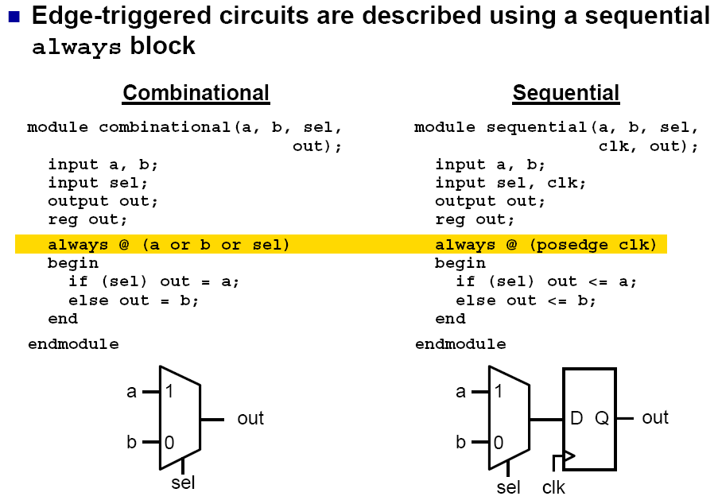
The Sequential always Block

Slide 55
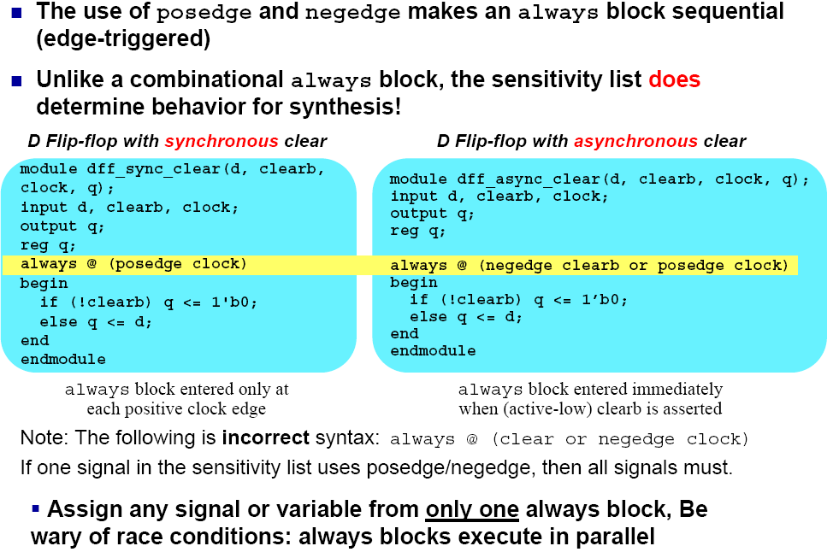
Importance of the Sensitivity List

Slide 56
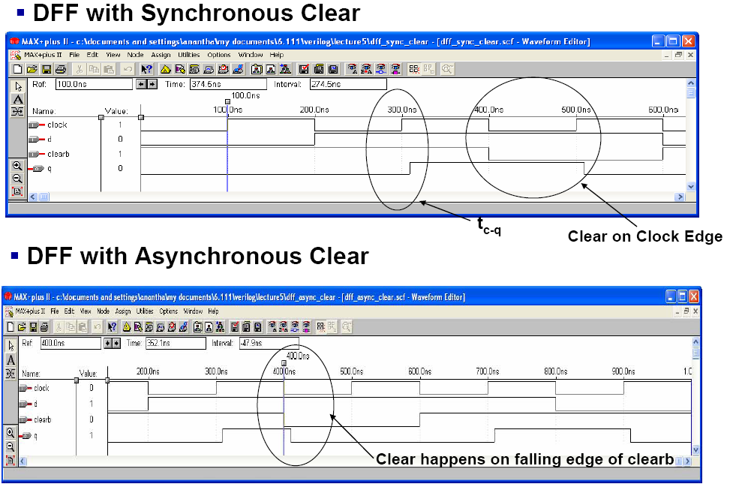
Simulation

Slide 57
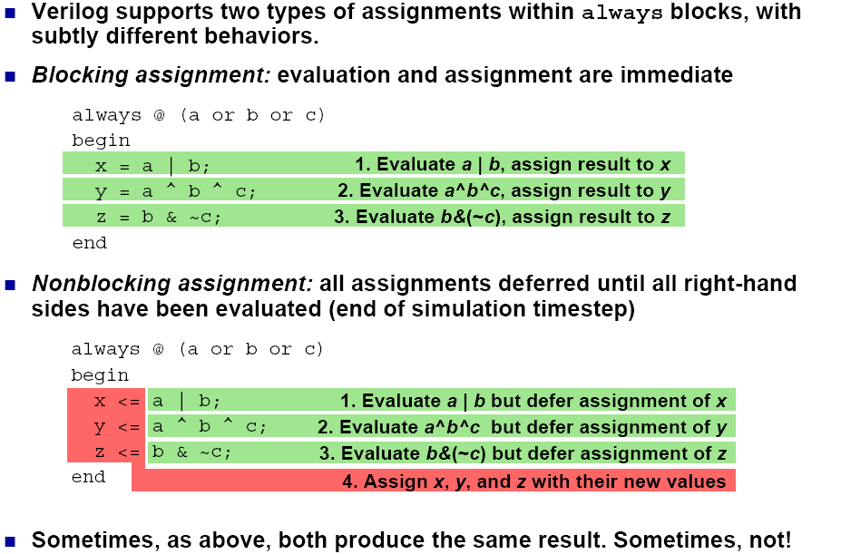
Blocking vs. Nonblocking Assignments

Slide 58
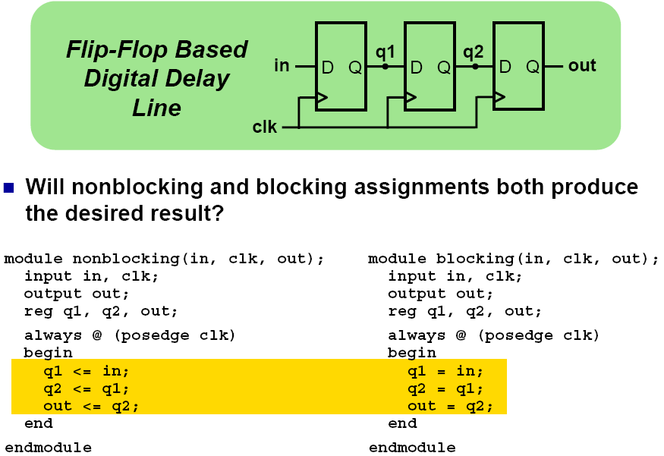
Assignment Styles for Sequential Logic

Slide 59
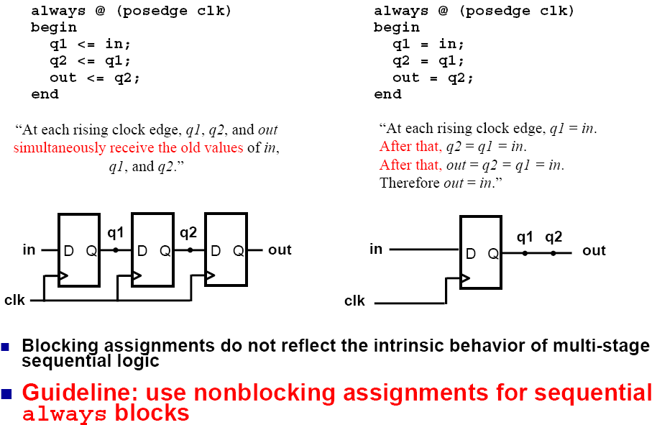
Use Nonblocking for Sequential Logic

Slide 60
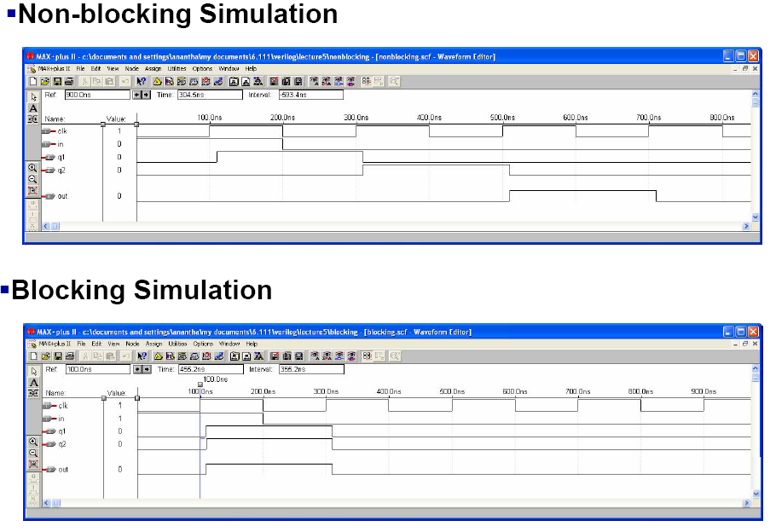
Simulation

Slide 61
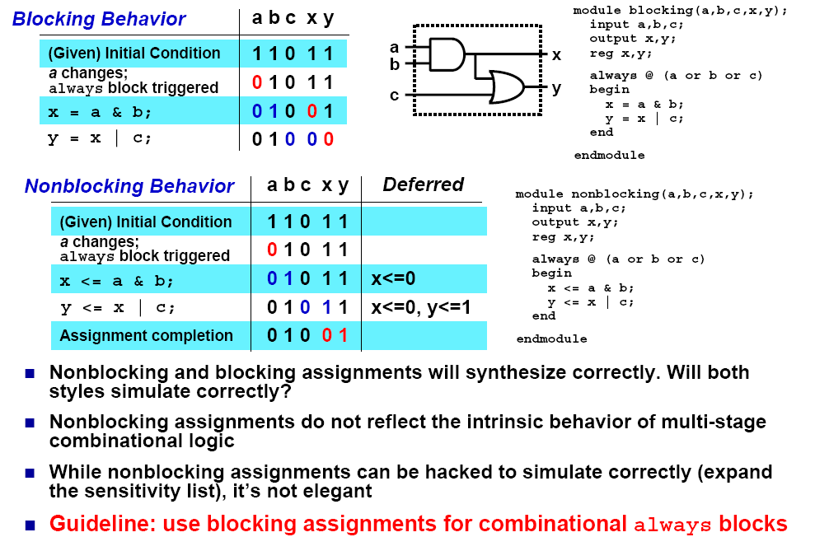
Use Blocking for Combinational Logic

Slide 62
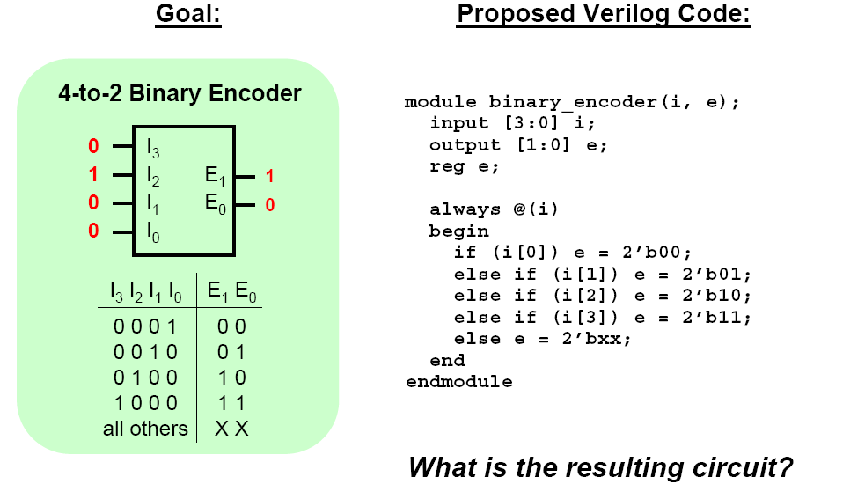
Dangers of Verilog : Priority Logic

Slide 63
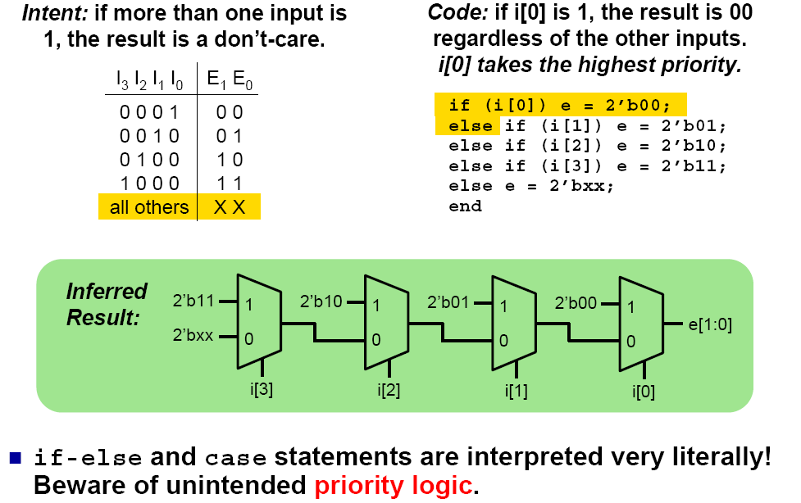
Priority Logic

Slide 64
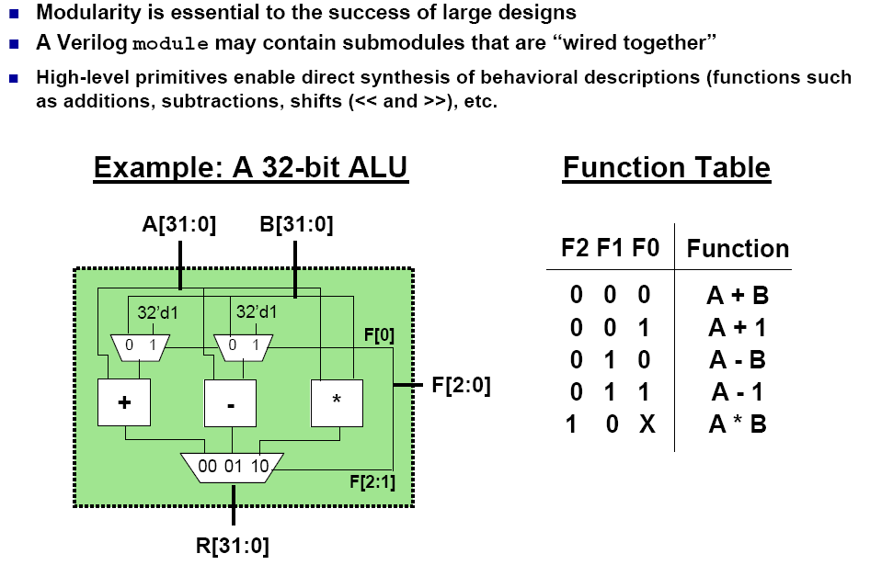
Interconnecting Modules

Slide 65
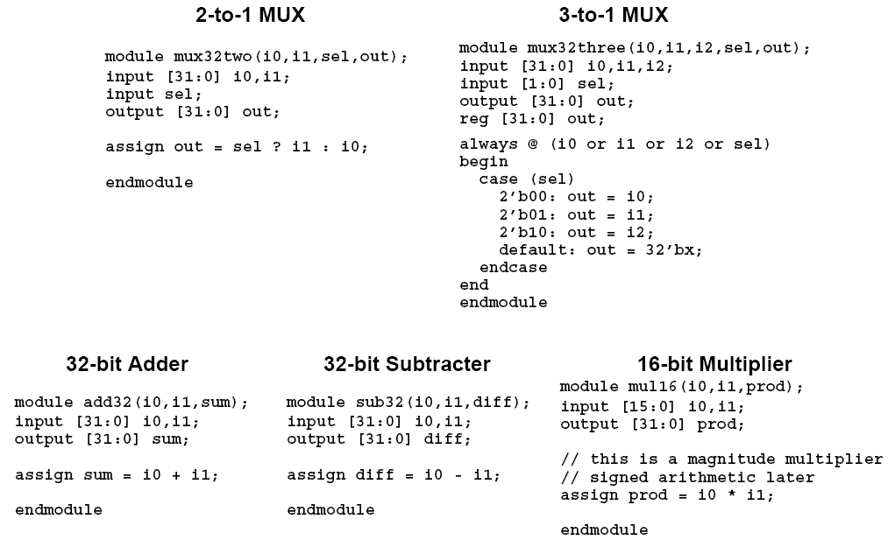
Module Definitions

Slide 66
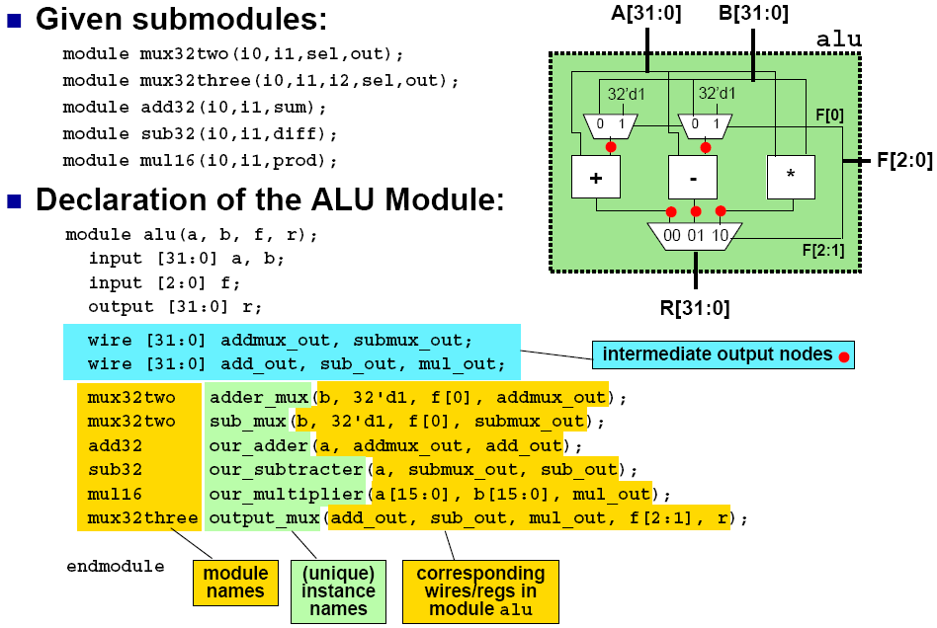
Top-Level ALU Declaration

Slide 67
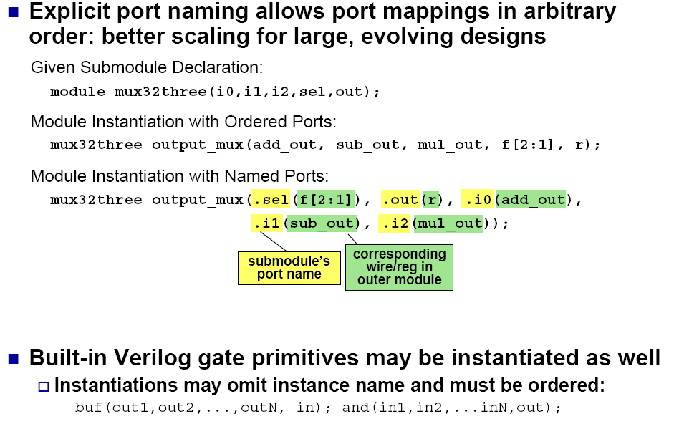
More on Module Interconnection

Slide 68
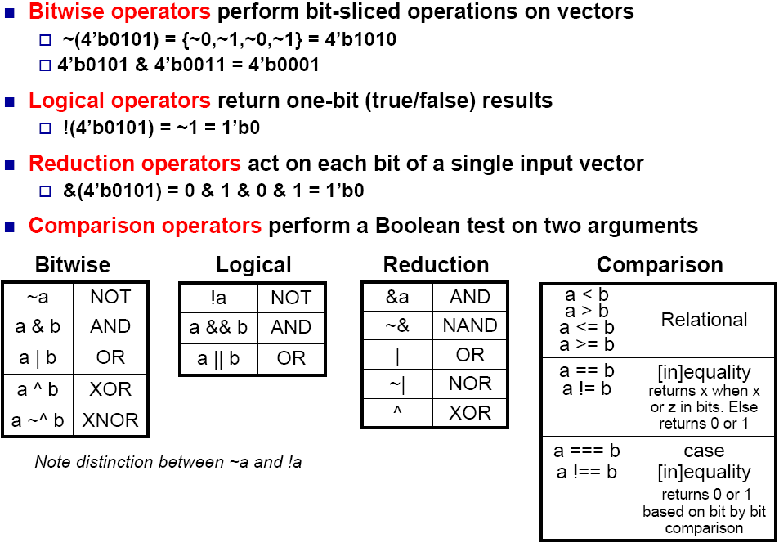
Useful Boolean Operators

Slide 69
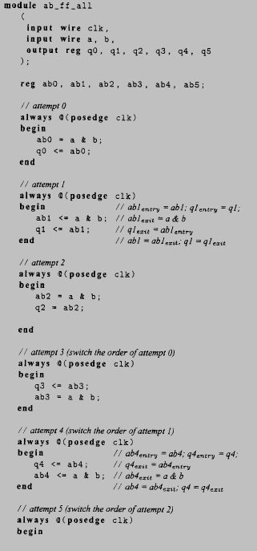
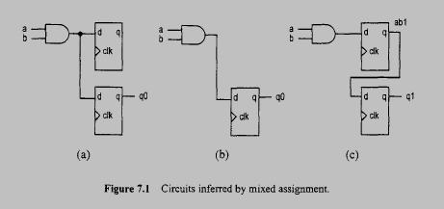
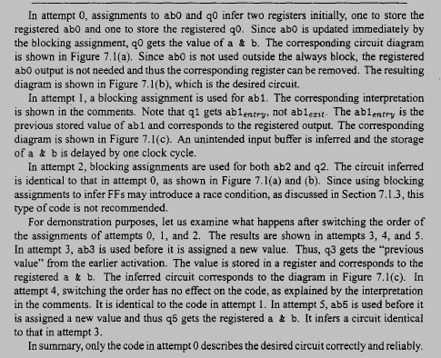

How to make your life miserable with Verilog

Slide 70
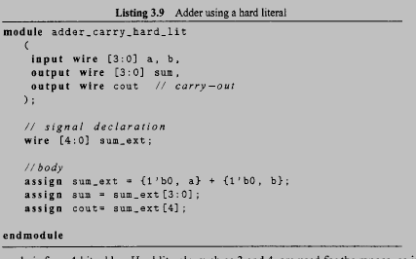
Adder – regular code

Slide 71
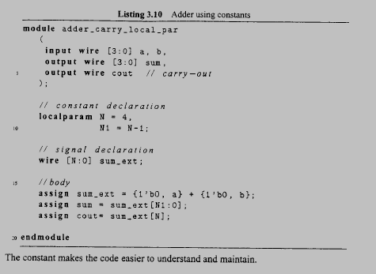
Adder – Better code

Slide 72
Parameter
Parameters are useful because they can be redefined on a module instance basis. That is, each different instance can have different parameter values. This is particularly useful for vector widths.
For example, the following module implements a shifter:
module shift (shiftOut, dataIn, shiftCount);
parameter width = 4;
output [width-1:0] shiftOut;
input [width-1:0] dataIn;
input [31:0] shiftCount;
assign shiftOut = dataIn << shiftCount;
endmodule
This module can now be used for shifters of various sizes, simply by changing the width parameter.

Slide 73
Define Parameter Value
There are two ways to change parameter values from their defaults, defparam statements and module instance parameter assignment.
The defparam statement allows you to change a module instance parameter directly from another module. This is usually used as follows:
shift sh1 (shiftedVal, inVal, 7); //instantiation defparam sh1.width = 16; // parameter redefinition
Parameter values can be specified in the module instantiation directly. This is done as follows:
shift #(16) sh1 (shiftedVal, inVal, 7);
//instance of 16-bit shift module

Slide 74
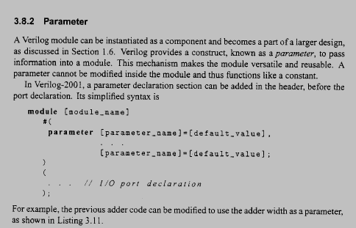
Parameters

Slide 75
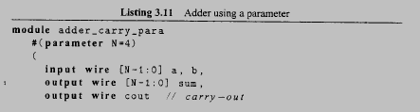
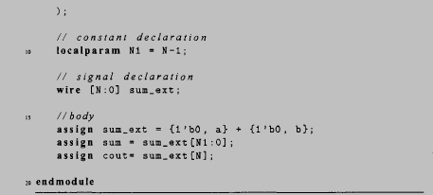
Parameter - Example

Slide 76
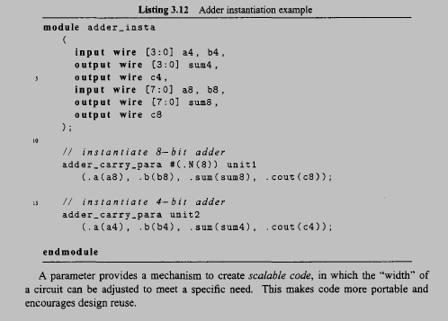
Parameter - Example

Slide 77
Generate Statements
Page 77
Notes:
77

Slide 78
Structural Descriptions
Suppose we want to design this circuit:
Further, suppose we already have a 4-input 1-bit mux component and
we want to create a structural description
Slide Set 6, Page 78
Notes:
78

Slide 79
A Structural Description: Verilog
module mux_16to1 (W, S, F);
input [15:0] W;
input [3:0] S;
output F;
wire [3:0] M;
// Second Stage Mux
mux_4to1 mux4 (M[3], M[2], M[1], M[0], S[3:2], F);
// First Stage Mux
mux_4to1 mux3 (W[12], W[13], W[14], W[15], S[1:0], M[3]);
mux_4to1 mux2 (W[8], W[9], W[10], W[11], S[1:0], M[2]);
mux_4to1 mux1 (W[4], W[5], W[6], W[7], S[1:0], M[1]);
mux_4to1 mux0 (W[0], W[1], W[2], W[3], S[1:0], M[0]);
endmodule
fdfd
Slide Set 6, Page79

Slide 80
Using Generate: Verilog
module mux_16to1 (W, S, F);
input [15:0] W;
input [3:0] S;
output F;
wire [3:0] M;
// Second stage Mux
mux_4to1 mux4 (M[3], M[2], M[1], M[0], S[3:2], F);
// First stage muxes
genvar i;
generate
for (i=0; i < 4; i=i+1) begin: big_mux
mux_4to1 mux ( W[4*i], W[4*i+1],
W[4*i+2], W[4*i+3], S[1:0], M[i] );
end
endgenerate
endmodule
fdfd
Slide Set 6, Page 80

Slide 81
Unrolling:
genvar i;
generate
for (i=0; i < 4; i=i+1) begin: big_mux
mux_4to1 mux ( W[4*i], W[4*i+1],
W[4*i+2], W[4*i+3], S[1:0], M[i] );
end
endgenerate
mux_4to1 mux3 (W[12], W[13], W[14], W[15], S[1:0], M[3]);
mux_4to1 mux2 (W[8], W[9], W[10], W[11], S[1:0], M[2]);
mux_4to1 mux1 (W[4], W[5], W[6], W[7], S[1:0], M[1]);
mux_4to1 mux0 (W[0], W[1], W[2], W[3], S[1:0], M[0]);
Synthesis tool replaces the Generate statement with the unrolled version before proceeding to actual synthesis
Slide Set 6, Page 81

Slide 82
Another Example: 4-bit Adder
Consider a 4-bit adder constructed from components of Full Adders
Full Adder takes three 1-bit inputs (A, B, Cin) and adds them to
produce two 1-bit outputs (Cout, S).
Slide Set 6, Page 82

Slide 83
Full Adder
module full_adder (A, B, Cin,
S, Cout);
input A, B, Cin;
output S, Cout;
assign S = A ^ B ^ Cin;
assign Cout = (A & B) |
(B & Cin) | (A & Cin);
endmodule;
Notes:
83

Slide 84
A Structural Description: Verilog
module add4 (A, B, S, COUT);
input [3:0] A, B;
output [3:0] S;
output COUT;
wire [4:0] C;
assign COUT = C[4];
full_adder FA3 (A[3], B[3], C[3], S[3], C[4]);
full_adder FA2 (A[2], B[2], C[2], S[2], C[3]);
full_adder FA1 (A[1], B[1], C[1], S[1], C[2]);
full_adder FA0 (A[0], B[0], C[0], S[0], C[1]);
assign C[0] = 1'b0;
endmodule
Slide Set 6, Page 84

Slide 85
Using Generate (Verilog)
module add4 (A, B, S, COUT);
input [3:0] A, B;
output [3:0] S;
output COUT;
wire [4:0] C;
genvar i;
assign COUT = C[4];
generate
for (i=0; i < 4; i=i+1) begin: fa
full_adder FA ( A[i], B[i], C[i], S[i], C[i+1]);
end
endgenerate
assign C[0] = 1'b0;
endmodule
Slide Set 6, Page 85

Slide 86
Conditional Generates
Conditional generates can be created in two ways:
if –else statements
case statements
Both of these statements can be used within the generate block.
Here is an example of using a generate statement to control the type of adder used:
// if-else
generate
if (adder_width < 8)
ripple_carry # (adder_width) u1 (a, b, sum);
else
carry_look_ahead # (adder_width) u1 (a, b, sum);
endgenerate
Note: The expression inside the if statement must evaluate to a static value.

Slide 87
GENERATE IF Statement
Slide Set 6, Page 87
Often times, when there is an opportunity to use a Generate For, there
are irregularities in a few of the instances
For example, in the Adder example,
the 0-th instance has an irregular carry-in (it is connected to ‘0’)
the last instance has an irregular carry-out (it connects to a port)
We dealt with this using some signal assignments. But we could also handle these “special cases” using a Generate If statements

Slide 88
assign COUT = C[4];
generate
for (i=0; i < 4; i=i+1) begin: fa
full_adder FA ( A[i], B[i], C[i], S[i], C[i+1]);
end
endgenerate
assign C[0] = 1'b0;
genvar i;
generate
for (i=0; i < 4; i=i+1) begin: fa
if (i == 0)
full_adder FA ( A[i], B[i], 1'b0, S[i], C[i+1]);
else if (i==3)
full_adder FA ( A[i], B[i], C[i], S[i], COUT);
else
full_adder FA ( A[i], B[i], C[i], S[i], C[i+1]);
end
endgenerate
Page 88

Slide 89
Generate Statement with Parameters
Generating multiple module instances of otherModule and connecting them:
module some_module(mod_out, A);
parameter SIZE = 8;
input [SIZE-1:0] A;
output [SIZE-1:0] mod_out;
wire [SIZE:0] intermediate;
generate
genvar i;
for (i=0; i<SIZE; i=i+1)
begin: instance_name
otherModule name(mod_out[i], intermediate[i+1], A[i], intermediate[i]);
end
endgenerate
endmodule

Slide 90
Memory Arrays
Efficiently store large amounts of data
3 common types:
Dynamic random access memory (DRAM)
Static random access memory (SRAM)
Read only memory (ROM)
M-bit data value read/ written at each unique N-bit address
Notes:
90

Slide 91
Memory Arrays
2-dimensional array of bit cells
Each bit cell stores one bit
N address bits and M data bits:
2^{N} rows and M columns
Depth: number of rows (number of words)
Width: number of columns (size of word)
Array size: depth × width = 2^{N} × M
Notes:
91

Slide 92
Memory Array Example
2² × 3-bit array
Number of words: 4
Word size: 3-bits
For example, the 3-bit word stored at address 10 is 100
Notes:
92

Slide 93
Memory Arrays
Notes:
93

Slide 94
Memory Array Bit Cells
Z
Notes:
94

Slide 95
Memory Array Bit Cells
0
Z
1
Z
Notes:
95

Slide 96
Memory Array
Wordline:
like an enable
single row in memory array read/written
corresponds to unique address
only one wordline HIGH at once
Notes:
96

Slide 97
Types of Memory
Random access memory (RAM): volatile
Read only memory (ROM): nonvolatile
Notes:
97

Slide 98
RAM: Random Access Memory
Volatile: loses its data when power off
Read and written quickly
Main memory in your computer is RAM (DRAM)
Historically called random access memory because any data word accessed as easily as any other (in contrast to sequential access memories such as a tape recorder)
Notes:
98

Slide 99
ROM: Read Only Memory
Nonvolatile: retains data when power off
Read quickly, but writing is impossible or slow
Flash memory in cameras, thumb drives, and digital cameras are all ROMs
Historically called read only memory because ROMs were written at manufacturing time or by burning fuses. Once ROM was configured, it could not be written again. This is no longer the case for Flash memory and other types of ROMs.
Notes:
99

Slide 100
Types of RAM
DRAM (Dynamic random access memory)
SRAM (Static random access memory)
Differ in how they store data:
DRAM uses a capacitor
SRAM uses cross-coupled inverters
Notes:
100

Slide 101
DRAM
Data bits stored on capacitor
Dynamic because the value needs to be refreshed (rewritten) periodically and after read:
Charge leakage from the capacitor degrades the value
Reading destroys the stored value
Notes:
101

Slide 102
DRAM
Notes:
102

Slide 103
SRAM
Notes:
103

Slide 104
Memory Arrays Review
DRAM bit cell:
SRAM bit cell:
Notes:
104

Slide 105
Multi-ported Memories
Port: address/data pair
3-ported memory
2 read ports (A1/RD1, A2/RD2)
1 write port (A3/WD3, WE3 enables writing)
Register file: small multi-ported memory
Notes:
105

Slide 106
SystemVerilog Memory Arrays
// 256 x 3 memory module with one read/write port
module dmem(
input logic clk, we,
input logic [7:0] a
input logic [2:0] wd,
output logic [2:0] rd);
logic [2:0] RAM[255:0];
assign rd = RAM[a];
always @(posedge clk)
if (we)
RAM[a] <= wd;
endmodule
Notes:
106

